Slide 1
Software Endgames
Learning to Finish What You’ve Started
Software Test & Performance Conference: April 17-19, 2007
Robert Galen
RGalen Consulting Group, LLC
www.rgalen.com bob@rgalen.com
Notes:
Titles:
Software Endgames: Negotiating the Defect Minefield Towards Successful Project Delivery
Software Endgames: Learning to Finish What You’ve Started
Abstract
Each of us has experienced more than one endgame in a software project, either from the perspective of developer, tester, manager or other team member. If you were lucky enough to participate in a "successful" endgame, then you were lucky indeed. The typical endgame is fraught with peril - products that don't work, requirements that aren't met, high bug counts, schedules that are a joke and teams that are overworked and burnt out.
This talk focuses on a set of high level practices and techniques that will help improve your management and steering within the endgame. Providing experienced guidance that will increase the odds of your success and delivery.
It's based on material in my forthcoming book – Software Endgames: Eliminating Defects, Controlling Change, and the Countdown to On-Time Delivery, published by Dorset House in December 2004.
5 Things an Attendee will Learn
- The importance of release criteria within the endgame and high level rules of thumb for defining them
- Endgame team do's and don'ts for managers
- How to setup a release framework for interim releases and effective management
- Managing defect repairs – where to focus and schedule rules of thumb
- Exploring the many ways to "fix" defects

Slide 2
Outline
The “Map” – Endgame Release Framework
The “Goal” – Release Criteria
The “Problem” – Those Pesky Defects
The “Strategy” – Reducing Change
The “Team” – Do’s and Don’ts
The “Result” – Success by letting it go…

Slide 3
Introduction
Software Endgames are…
  Period from 1’st release for testing outside of development thru to final customer release
  Independent of methodology, although agility does introduce some “exceptions”
  Primarily the domain of the testing team
  Perhaps 40% of the overall project effort
  Pressure packed towards – Release!
Notes:
Emphasize my contention that the “battle” is typically won or lost within the endgame. It’s not only where defects / rework surface, but where requirements get realized – for good and bad.

Slide 4
Introduction
Let’s collect some data around your past endgames –
  What are some of the core characteristics or patterns in a typical endgame?
  What habits or patterns have you seen that work well to ensure a successful project outcome?
  Other observations?

Slide 5
Introduction
My Goals
  Get you to think about your Endgames as a significant phase of your project and convince you that Endgames deserve your attention
  Provide examples and tools to manage “change” activity during this time
  Have you takeaway just ONE technique to apply in your next endgame

Slide 6
Endgame Release Framework
You can’t get to where you are going without some sort of MAP…

Slide 7
Map – ERF
Defined
High level plan for negotiating the Endgame, containing –
  Historical Notes
  Plan Details
  Endgame Workflow
Derived collaboratively with all major functional stakeholders (marketing/customer, development, testing, documentation, PM)
Usually posted in a project wide locale and updated in real-time with Endgame adaptations
Notes:
The ERF is the major planning tool for the Endgame. It’s composed of three primary parts:
Historical notes from previous teams and endgames. This is “interviewed” from the team and “derived” from previous project artifacts and defect analysis.
Plan details, which are your typical plan points – team structure, leadership structure, decision-making methods, CCB construction, methods for transitioning releases to QA (integration)
Workflow, the release by release cycle flow with emphasis on Themes, Entry/Exit Criteria and Testing focus

Slide 8
Map – ERF
Components
Historical Notes
  Testing cycle characteristics
  CCB meeting frequency, defect rates
  Defect rates – find rates, repair rates, avg. TTR, deferral rates
  Historical observations of
    Code freeze maturity
    Development team quality trends
    Test team performance trends
Notes:
This is usually an interviewing and mining activity. You want to get as much information from the “environment” as possible.
There are many patterns that need to be mined to prepare for each endgame. Of particular importance –
Defect rates and the rate at which previous project “settled” into an acceptable, ship-able state
QA testing cycle times, for interim releases and complete coverage cycles
TTR characteristics, to predict the repair patterns and bandwidth of the development team
Overall defects generated, in meaningful categories and towards specific product / skill areas

Slide 9
Map – ERF
Components
Plan Details
  Team organization (leadership, key roles & responsibility)
  Number and type of testing passes or phases, for example:
      Pass 1 - exploratory and familiarity testing
      Pass 2 - re-work verification and regression testing
      Pass 3 - re-work verification and regression testing
      Pass 4 – final verification, regression and packaging testing
  Handling of initial defect triage
  Build and integration responsibilities
  CCB logistics and attendee list
  Alpha/Beta testing passes – focus and requirements

Slide 10
Map – ERF
Components
Endgame Workflow - For each release (iteration, pilot, focus group, Alpha/Beta, etc.) for testing define the following:
  Testing focus or intent for this release
    Initial, Regression, Beta pre-qualify, New features, Repair verification
  Functionality % coverage targets
  Other testing targets – performance, acceptance, etc.
  Test duration, # days or weeks
  Clear Entry & Exit criteria

Slide 11
Map – ERF
Define a Strategy
As part of the Endgame Flow, you should define a strategy for estimating testing cycles and times, based on the history of previous endgames –
  Testing cycle time
  Defect trends & settling times
    Zero bug bounce, S-curves
  Cycles to achieve code freeze, code stability, final release quality levels
  Patterns for: New feature introduction, Regression testing, Repair verification, Maturation phasing, Pareto defect trending
Notes:
You should also have a strategy of introducing the following in “packages” that create a productive flow for the maturation of the product, testing efficiency
What are the typical factors:
Freezing the code base, either in pieces or as a whole
Releasing sets of repairs (test blockers, groupings of related repairs, prioritization flows)
Meeting typical Endgame milestones (Alpha/Beta, prototypes, pilots, etc.)
Numbers of “packages” are mostly determined by history and some gut feel – what’s different this time – analysis.

Slide 12
Map – ERF
Release Workflow Example
Initial Release to Test - Pass #1: January 15, 2000
  Focus: Initial testing – familiarity with product and level of quality
  Functionality 80% complete, estimated test time 2 weeks @ 75% of delivered functionality
  Entry criteria: release notes, unit test results and release review meeting for quality overview and candidate pass smoke test
  Exit criteria: Testing @ 50% complete, 2 weeks elapsed time
Release to Test - Pass #2: January 30, 2000
  Focus: Testing new functionality, regression testing, verification testing and initial probing of system performance
  Functionality 95% complete, estimated test time 2 weeks @ 100% of delivered functionality
  Entry criteria: release notes, unit test results and release review meeting for quality overview and candidate passed smoke test
  Exit criteria: Testing @ 80% complete, 2 weeks elapsed time
…
Notes:
Example from the book. It should cascade to cover all of the release points for the project within the endgame.
Two critical points – have a focus/vision/point for each release and have, at the very least, loosely defined entry/exit criteria for that release.

Slide 13
Map – ERF
Release Plan Example
Build/Qual Milestone | Date | Notes
Pre-DVT Pkg 5.2.1 | 8/25/03 | 5.2.1.0
Pre-DVT Pkg 5.2.2 | 9/8/03 | Original build had two P0 bugs. Respin still has issues that are being investigated.
Pre-DVT Pkg 5.2.3 | 9/22/03 | Want to deliver new HW support in this pkg
RIT Pkg 5.2.4 | 9/29/03 | 1 week Release Integration Test beginning on 9/30
1st DVT Pkg 5.2.5 | 10/6/03 | 2 week qual beginning on 10/7 (re-spin MWare mid-cycle)
… | … | …
DVT Pkg 5.2.10 | 12/28/03 | 2 week qual beginning on 12/29 (re-spin MWare mid-cycle)
DVT Pkg 5.2.11 | 1/12/04 | 2 week qual beginning on 1/13 (re-spin MWare mid-cycle). Possible beta refresh candidate.
DVT Pkg 5.2.12 | 1/26/04 | 3 week qual beginning on 1/27
RTM Candidate Pkg 5.2.13 | 2/16/04 | 3 week qual beginning on 2/17. RTM target 3/9/04.
Notes:
This is an actual example from EMC. It was defined early on, probably a month before the actual first release. It was based on historical experience and test cycle times. You also see places for internal development introductions (DART re-spins, Beta refresh, Hammerhead, etc.) that reflect development requirements or patterns.

Slide 14
Map – ERF
Sabourin’s Test Cycle Rule of Thumb
After code freeze, it minimally takes 3 testing cycles to complete testing. Due to the nature of testing, bugs and software, the first cycle takes twice the effort of the second. If the effort to complete the third cycle is A then the total test effort after code freeze should be (7 * A)
Therefore, if you are allocated a testing budget of B hours, tests should be designed so that a complete cycle, without blocking bugs and with complete passes, will require (B / 7) person hours to complete!
It is a sanity check for test estimation. If (B / 7) is unreasonable then you either need to increase B or scope down the project!
Notes:
So, if a nearly perfect testing cycle is 2 calendar weeks of effort for entire testing team, then the Minimal testing time after code freeze is 7 calendar weeks. Allowing for rework and retesting.
I like basic heuristics that guide our thinking about endgame dynamics. Don’t get hung up on the numbers or method, use it as a model for your organization and create your own.

Slide 15
Release Criteria
You can’t determine if you’ve ARRIVED unless you know what the GOAL is…

Slide 16
Goal - Release Criteria
What Are They?
From this perspective, criteria guiding ultimate product release decision-making
  Linked to Requirements
  Linked to the Customer & Business
  Linked to the Product & Team
Normally defined within Requirements phase of the project
Notes:
Poll the audience for their experience regarding release criteria:
How many actually define and use Release Criteria regularly within their projects?
How many have “halted” a release sequence because of failure to meet the criteria?
How many have “static” criteria defined early vs. “dynamic” criteria?

Slide 17
Goal - Release Criteria
Johanna Rothman
Johanna Rothman – 5 Steps for definition
  Define Success
  Learn What’s Important for This Project
  Draft Release Criteria
  Make the Release Criteria SMART
    Specific, Measurable, Attainable, Realistic and Trackable
  Gain Consensus on the Release Criteria
Binary interpretation – (pass or fail) (go or no-go) intended to drive release decision-making
Changed infrequently – holding to your initial goals!

Slide 18
Goal - Release Criteria
Rothman Example
Example Release Criteria –
  The code must support both Windows 2000 and Windows XP
  All priority P0, P1 and P6 defects will be repaired / addressed
  For all documented bugs – on-line help, release notes and formal documentation will contain relevant updates
  All QA tests run at 100% of expected coverage
  No new P0 – P3 defects found within the last 3 weeks
  Release target – GA of April 1, 2005
To the left is a sample set of release criteria intended to guide activity for a given release. They speak to –
  Platforms
  Defects allowed
  Defect actions
  Coverage
  Maturity
  Performance
  Release date

Slide 19
Goal - Release Criteria
Working View
Working View – A different sort of Release Criteria
Dimensional across – Scope, Quality, Time, People, Cost targets
Graphical – To better illustrate the trade-offs and balance
Hierarchical – Defined at a high level, then explored for each low priority dimension
Explored, defined and changed with the team – Truly collaborative based on discovery and adjustment
Notes:
The problem we're trying to solve is effective decision-making. This becomes particularly crucial in the triage or endgame processes. To often the following problems arise –
General team decision making is difficult and usually ad-hoc in nature
It can take too long
May not include the right group or team in the decision
Decisions can be too heavily influenced by the wrong factors, for example, the strongest, loudest or most extreme personalities and voices
Political factors
Often decisions go undocumented and don’t stick for very long
Usually biased towards one functional group, with very little balance or compromise at the individual decision level
All of this is exacerbated in the endgame because of the number of decisions that need to be made and the intense pressure on the project

Slide 20
Goal - Release Criteria
Working View
Working View – 5 Steps
  Identify Project Stakeholders
  Set the Stage
  Establish Project Vision, Essence, Release Criteria
  Explore Project / Product Dimensions
  Iterate & Adapt
Dynamic, team based with strong emphasis on trade-offs
http://www.rgalen.com/t_files/AspectsOfAProjectWorkingView_v2.doc
Notes:
Generally similar to Johanna’s view. Differences include:
Clearly identify stakeholders and CONTINUE to involve them (as appropriate) in the evolution of the Endgame Working View
The setting the stage exercise if truly important. This is where to expand upon crucial features, business or economic challenges, team challenges, time challenges, virtually anything that is going to be a problem or impediment – get it in on the table and face it in your Working View
The setting the stage activity has two intents. There is the Original stage setting and an Working View Adjustment stage re-setting event. It’s particularly important in the latter to identify WHY the adjustment is occuring.
Vision/Essence are much broader than Johanna intends.
The dimensional view is also different – in that it forces us to consider the FORCES working within a project and view & analyze the trade-offs.
I get the feeling that Johanna leans towards a more discrete criteria setting event, while I consider it truly adaptive and iterative.

Slide 21
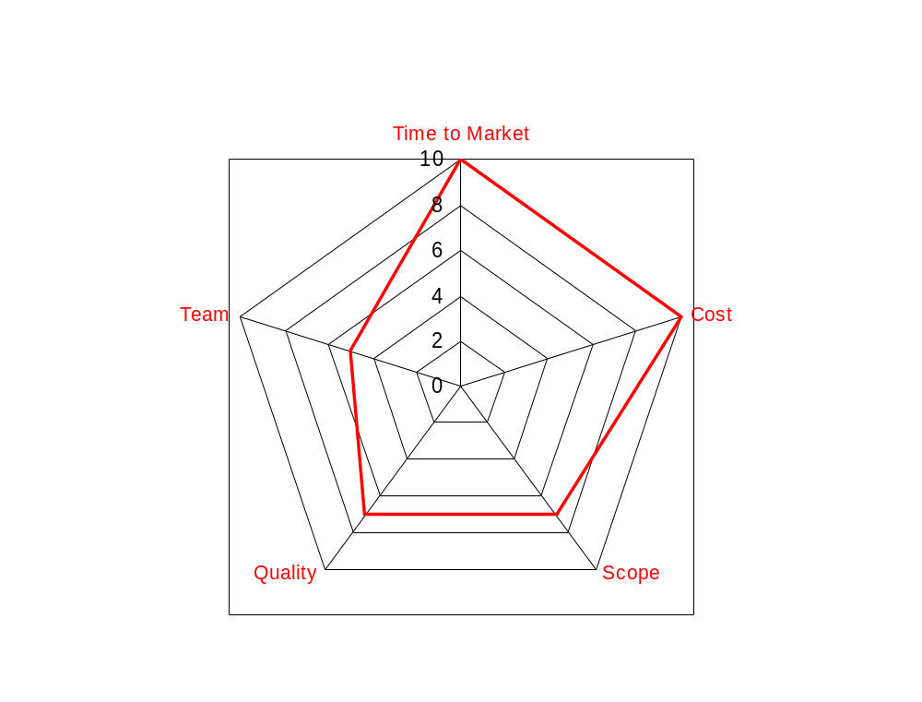
Goal – Release Criteria
Working View Example
Participants
  Product Manager, Project Manager, VP of Engineering, Marketing and Testing/QA
Dimensions of the problem
  We are not able to acquire additional experienced resources
  TTM is our ultimate priority – our customers and the business need the release
  We must work some overtime – give extra effort
  We can’t regress deployed functionality – even in the interoperable cases – and we must include all field based severity 1-2 repairs
Ranking
  TTM = 10 & Cost = 10,
  Scope = 7 & Quality = 7,
  Team = 5
Notes:
This is a High Level starting point for any working view exercise. It helps to explore and establish the core balancing proposition for any product endgame. While it might seem trite or unimportant, my experience is that release criteria goes awry at a HL view first. The team simply doesn’t understand the overall priority view.

Slide 22
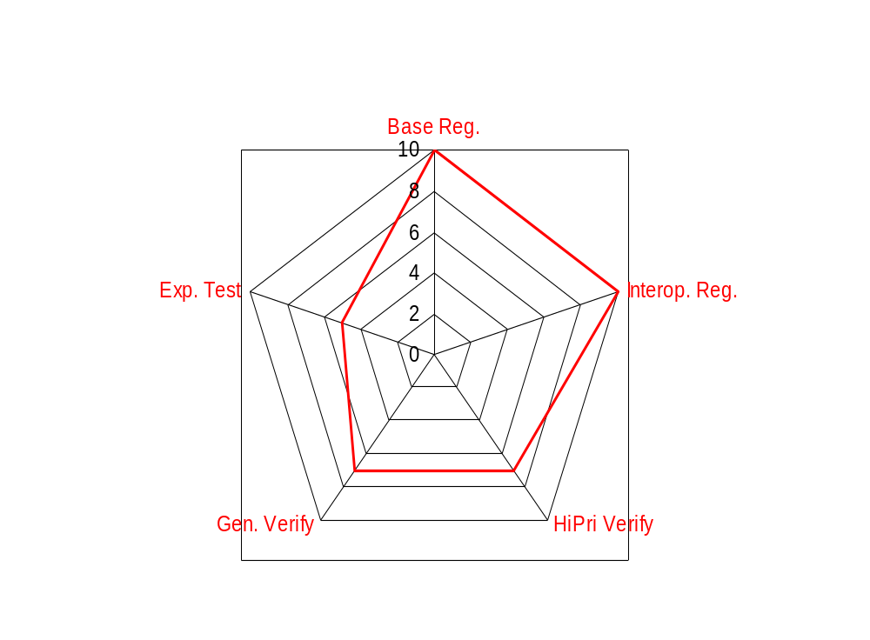
Goal – Release Criteria
Working View Example
Participants
  Product Manager, Project Manager, Team leads from development and testing functions
Dimensions of the problem
  Insure we have full regression tests for deployed functionality – continue to run tests & report results
  Extend existing regression tests to insure interoperability is covered
  New additions to regression suite
  Repair verifications may lag behind
  We can't perform any ad-hoc testing
Ranking
  Previous version regression = 10,
  Interoperable regression = 10,
  1 & 2 repair verification = 8,
  General verifications = 6,
  Exploratory testing = 2
Notes:
Moving from the previous view, we now explore the implications to the test team. We start looking at the workload balance and prioritization within their efforts. This is exactly how you want to drive the views as you “drill down”.
You could have a similar view for development. What would be the higher priority items and what would be lower?

Slide 23
Goal – Release Criteria
Working View Example
An alternative approach is High / Low or
Do / Don’t Do Contrasting Charts
High Priority / Focus
Existing functionality can not be affected by new changes - (functional regression testing)
Existing performance may not be degraded by new changes - (performance regression testing, we also lacked a performance benchmark)
New functionality must work
Component interoperability w/o performance regression
Low Priority / Focus
Interfaces beyond 10/100/1000 Ethernet and ATM are lower priority
Existing performance may not be degraded by new changes - even when running multiple components, don’t get hung up on improvement
New functionality must work, except new reports that do not map to older reports
Component interoperability across all permutations, we can identify (n) key
Notes:
Even with all of the graphics, this tool is probably the best vehicle to differentiate focus within endgames. The starker the contrasts the better the team clarity and decision-making. You can do it cross functionally –
Development: will unit test and will not unit test, will design and will not design
Test: will test and will not test, will automate and will not automate, will examine with each iteration and will not

Slide 24
Those “Pesky” Defects
Defects are the core IMPEDIMENT to your reaching a successful release. How you DEAL with them makes all the difference…

Slide 25
Problem – Those “Pesky” Defects
Add “Dimensions” to Repairs
In my experience, organizations get too caught up in binary repairs decisions – fix or don’t fix. They therefore miss tremendous flexibility in their decision-making
  Good software project managers should guide their teams’ defect triage towards multi-faceted repair decisions
  Good testers and test teams should help remind their projects of these options
Notes:
I should also mention the team implications of this view. Usually there is morale fall-out. The development team may feel that it can’t possibly keep up with all of the defects and the testing team feel that enough defects aren’t getting repaired.

Slide 26
Problem – Those “Pesky” Defects
Add “Dimensions” to Repairs
Repair
Make only a “partial” repair to buy some time
Log it as “known” and move on
Change the priority and/or severity to reset your “view” to the defect
Ignore it and hope for the best
Consider it anomalous behavior and wait for the next occurrence
Defer the repair to a later release
Negotiate with marketing or the customer for “relief”
Add more system resources to reduce the impact
Find a work around
Remove the offending code
Change or remove interacting software products
Notes:
I consider all of these perfectly viable. The problem comes in the frequency of application. You should somehow track how many of these decisions are made and look for excessive or unhealthy application of any of these specific options. Typically release pressure will increase during the span of the endgame, so misuse will be an increasing risk.
Another point is that repairs can migrate across these options within a single endgame. That’s normal as well.

Slide 27
Problem – Those “Pesky” Defects
Add “Dimensions” to Repairs
Of course each one of these decisions has its own decision criteria and context and “depends” on –
  Priority, customer impact, business impact
  Team bandwidth and overall schedule
  Previous defect trends, specific product domain
The “Working View” can be particularly helpful here in making these decisions
Remember – there is always next time…
Notes:
In my experience, inexperienced endgames focus on repair, workaround, don’t repair, wait options. The CCB is the key venue to influence more breadth and options when dealing with defects.
In fact, mention that the key target for the working view is the CCB team and (indirectly) functional leadership. It should create a single, clear, unified view that they all understand where they need to devote their efforts and energy for this project to be successful.
You can measure the quality of your release criteria, whether it be

Slide 28
Problem – Those “Pesky” Defects
Directing Repairs
I’ve seen too many teams approach defect repairs without any direction –
  Simply picking what you want from the list
  Little thought to repair efficiency, side effects, regression risks
  Over-loaded and under-loaded resources
  Developers making repairs to unfamiliar code
  Little thought towards repair “packaging” – outside of priority
  Little overall repair time estimates / predictability
Notes:
I’m saying that the typical endgame defect repair strategy is chaotic, not terrible, but certainly not optimized. I usually see two key trends
A few resources, usually the most skilled or broadly familiar resources, are incredibly overload (both with sheer numbers and the most critical repairs). The remainder are working, but are essentially underutilized and not contributing fully to the endgame.
There is no intelligent packaging of defects. They make the next build/release when they are fixed. Almost regardless thought (number of repairs in the release, interrelationship of the repairs, features arriving in the release, regression potential, ability of testing to actually “handle” the release, etc.).
While some of this will probably always occur, I prefer to DIRECT the focus rather than REACT to repairs…

Slide 29
Problem – Those “Pesky” Defects
Directing Repairs
Concept of Work Queues implemented from within any Defect Tracking system
Work Queue:
Taking a defect stream from the DTS, assigning them to the engineers considering –
Resource work loading rules
Current work loading
Skills
Schedule intent
Future plans
Triaged defects:
Priority
Schedule placement intent
Assignment intent
Notes:
Very simple notion or concept:
Using the Defect Tracking System and “profiles” for the development team
Pre-estimate defects (just a little and quickly) to determine
Level of difficulty and complexity and who best to repair
Defects are reasonably and equally distributed across the team (with some heuristics)

Slide 30
Problem – Those “Pesky” Defects
Directing Repairs
Resource Profile define for each developer
Describes the abilities and constraints around defect repairs
Helps to guide effective repair assignments and proper load balancing
Engineer Name
Time allocated (hours per day or week) for repairs
What are their particular areas of expertise
Bandwidth - this is defined by the team lead and the engineer. Things that come into play include –
Are they providing leadership or mentoring to others
Overall experience level
Experience level with particular components
Debugging abilities
Ability to handle high severity / priority defects, how many at one time
Ability to work on tasks in parallel
Current loading - from the defect tracking system, assigned defects in severity order for planned releases 1…n
Notes:
As alluded to in the last slide, it’s a really good idea to have a “profile” for each developer within the endgame. It can be some details stuck on a 3x5 card or just informal familiarity with the skill mix and experience of the team.
It also forces us to think about other skills, for example debugging skill and tolerance for stress and confidence in repairing highly visible and critical defects. Thinking about and applying these intangibles effectively is as important as the more concrete skills.

Slide 31
Problem – Those “Pesky” Defects
Packaging Repairs
Work Queue:
Taking a defect stream from the DTS, assigning them to the engineers considering –
Resource work loading rules
Current work loading
Skills
Schedule intent
Future plans
Triaged defects:
Priority
Schedule placement intent
Assignment intent
Packages:
ERF targets
Repair “reality”
Adjust to latest “intent” for progress
Notes:
The additional point here is towards “packaging”. As you get repairs made, you look for the next realistic point in the ERF to release or bundle the repair with others. This thoughtful step seems to be atypical to me in most projects. It also means you may defer releasing repairs, which has a con side of exposure.

Slide 32
Problem – Those “Pesky” Defects
Packaging Themes
Packages should be planned to have “Themes”, here are a few examples –
  The very FIRST release to test
  Showstopper package(s) that contains one to only a few repairs to remove obstacles that have slowed or halted testing
  Interim package(s), for releasing repairs and new functionality
  Major releases and Minor releases, each containing large and small amounts of changes respectively
  There is the Code freeze package for a particular piece of functionality, component or the entire product
  The LAST package, the one with ALL of the final agreed fixes in it that need verification
Notes:
I really like the notion of “themes” because it really focus’ the team on a specific intention for each release. This helps development to understand the usage for the release and the testing team to craft a strategy focused towards the theme. It also helps with triage decisions – cause one to apply right sets of repairs to the right themes.
The themes should be a defined as part of the ERF. As changes in view are made to the plan/ERF, the themes flow should be adjusted as well.
You should avoid LARGE scope themes being strung together. Instead, there should be a tempo to the Endgame. An ebb and flow of progress, then clean-up/pause. Not only is this healthy within the team, but it reduced the amount of rework as well.

Slide 33
Problem – Those “Pesky” Defects
Packaging Themes
Themes help to –
  Create a sense of release tempo throughout the Endgame
  Focus the development and testing teams towards the primary goals for each iterative release
  Help to drive discussion around appropriate loading (changes) given the theme for the release
    To load balance the release with work that development can produce and testing can consume
  Create hand-off expectations
Should be developed as part of ERF creation
Define your overall maturation strategy

Slide 34
Reducing Change
Independent of methodology, at some point change becomes the enemy and you need a STRATEGY to reduce and ultimately stop it…

Slide 35
Strategy – Reducing Change
Drivers
Reducing change is all about repair decision-making –
  Given your release criteria
  Given product requirements
  Given business goals
  Given defect trending and product quality levels
  What needs to be repaired and when?
At some point, there needs to be discussion and a decision

Slide 36
Strategy – Reducing Change
LW-CCB Characteristics
LW-CCB (Lightweight - Change Control Board)
  Simply a periodic meeting
  All stakeholders involved, crisply facilitated by a meeting Chair
  Repair decisions (priority / impact based)
  Guide team repair activity w/results logged in DTS
Other dynamics
  Defects can be triaged offline (preferred state and > 70% should be handled this way)
  Lots of offline investigation and collaboration
Notes:
I create this notion of a LW-CCB just to sensitize folks into keeping the meeting scope and intent in the right spirit. I think of the typical CCB as being bureaucratic, formal, needing to examine all changes and quite slow in decision-making. This will simply not work in an effective Endgame.
That being said though, you DO need a decision-making body that guides repairs.

Slide 37
Strategy – Reducing Change
LW-CCB Agenda Structure
Notes
  Quick functional status
  Review decisions or analysis
  Majority of time (70%) spent here
  Quick look at project trends
  Based on meeting, adjust?
  Minutes / DTS updates
  Productivity/flow of LW-CCB
7 Phase
Meeting Structure
  Functional Roundtable
  Old Work Review
  New Work Planning
  Examine Trending
  Release Criteria Adjustments
  Meeting Follow-up
  Meeting Metrics
Notes:
Time spent:
Functional roundtable: 3-5 minutes, very fast checkpoint for major state
Old work review: if the CCB is functioning well, there should be little need to revisit carryover issues – exception is analysis
New work: 45-50 minutes of every hour should be spent here. A good rule of thumb for review performance is 2-3 minutes spent on each defect of 20-30 for every 30-45 minutes of meeting time.
Examine trending: 1-3 minutes, where are we currently heading…
Release criteria adjustment: 1-3 minutes, don’t do it in the meeting, just discuss whether an adjustment is required and do it offline
Meeting follow-up: Minutes should be sent out the day of the meeting. DTS defect entries need to be updated with CCB update by Noon the following day.
Meeting metrics: should be analyzed by the Chair of the CCB periodically.

Slide 38
Strategy – Reducing Change
LW-CCB “Feelings”
A “good” CCB meeting has the following attributes or feelings associated with it –
  The meeting started and ended on time and it was fully attended.
  The time was efficiently managed and well spent. There was a feeling of solid accomplishment.
  The meeting was well led and facilitated, clearly someone was in charge of the meeting.
  The team was properly prepared, doing the requisite off line “homework” required in defect analysis.
  We didn’t solve the problems, we triaged them.
  Most of the defects reviewed felt right. That is, they were defects that required a group decision and you could understand why they were discussed at the CCB.
  Meeting follow-up occurs naturally. Defects are updated with results, minutes are sent out quickly, plans are adjusted appropriately and actions are assigned.
Notes:
I usually put a lot of stock in how the meeting “feels” – along with the results. If I’m the chair of the meeting, I also pick a few attendees to serve as my compass for the meeting. They give me alternative perspectives to gauge progress and help with any necessary adjustments. They are also my co-facilitator’s, with a vested interest in leading a “tight” meeting.
You can also simply reference review rates. If you’re exceeding my average rates of (A good rule of thumb for review performance is 2-3 minutes spent on each defect of 20-30 for every 30-45 minutes of meeting time) then you’re focus is wrong.

Slide 39
Strategy – Reducing Change
Code Freeze
Along with a well defined CCB structure, the team needs to have a notion of “code freeze”
Total code change freedom
No change controls
Early evolution of the product
Code additions not necessarily reviewed and impact not analyzed
No active change control board (CCB)
Limited code change freedom
Review of changes & impacts
Change increasingly limited over time
Code additions are reviewed and analyzed for impact
Increasingly active CCB
Code Freeze
Total change control
Only regressions and critical defects repaired
All additions extensively reviewed and analyzed
Active CCB
Notes:
CCB and the ERF controls the funneling down of change towards release.
You can and should measure the Level of Change in raw repairs, LOC, or other quantifiers, so that you can track your reduction rate and see if it meets your plans.

Slide 40
Strategy – Reducing Change
Microsoft - Code Complete
Microsoft employs a “code complete” strategy as defined below –
Various project milestones
Visual Freeze
Feature Complete
Code Complete
Release to manufacturing
Stabilization leading to a zero bug fix release
Activity:
Pilots
Alpha/Beta testing
Time buffer
Iterative testing and rework
Notes:
Another way of viewing the “funneling” effects, from a Microsoft Code Complete POV. Their milestone is a true code freeze from a functionality perspective.

Slide 41
Strategy – Reducing Change
Schoor – Bug Fix Gates
Bruce Schoor has an extension to the Microsoft “code complete” strategy as defined below –
Code Freeze / Complete Milestone
UBF, Unlimited Bug Fix
LBF. Limited Bug Fix
RC, Release Candidate
Testing Focus
Systematic Test Passes
Production & Regression Tests
Acceptance Tests
Release Goals
Reduce # of High Priority & Severity Defects
Drive to Zero Defects
No More Fixes & Release
UBF – LBF
Gate
LBF - RC
Gate
Notes:
Another way of viewing the “funneling” effects. Bruce evolved this view from the Microsoft Code Complete phase. He added the different levels (testing & goals) to it. You could even add a development layer if you wished. In this view, there are more formal gates traversed between the phases. The gates have specific exit / entry criteria associated with each.

Slide 42
Strategy – Reducing Change
It Takes Courage
It’s easy to keep repairing defects…
  It creates a sense of accomplishment
  You’re doing it for the customer
  Quality is job #1
It’s hard to drive towards a release point
  Effective prioritization, good judgment, and managing risks
  Focusing on goals and making just the right amount of adjustments
Notes:
As odd as it might sound, many teams have a very difficult time actually stopping the Endgame cycle and releasing the software. I think it’s similar to the “analysis paralysis” effect that I’ve seen on so many projects.
It actually takes a lot of leadership, focus and courage to stop – and call a release of sufficient quality to warrant release. Unless you fix every defect, there is always that lurking risk.

Slide 43
Teams – Do’s & Don’ts
Endgames are the most pressure-packed times within your projects. If you don’t handle your TEAM effectively, you will fail in the short and/or long term…

Slide 44
Team – Do’s & Don’ts
Leadership
DO:
  Have a leadership perspective of “Servant Leadership” realizing you’re there for the team
  Bring a positive and energized attitude every day
  Understand the power of leadership – It Matters!
  Use overtime in short bursts - judicious, infrequent, selective and targeted
DON’T:
  Be too self or business centered as a leader
  No faster way to screw up an Endgame than to dictate overtime
Notes:
Could tell the story from Micrognosis and how folks interpreted my illness. As a means of understanding the power of leadership.
Endgame leadership needs laser focus, courage and experience. It’s a combination of ScrumMaster and Patton.

Slide 45
Team – Do’s & Don’ts
Roles & Responsibilities
DO:
  Setup specific roles for team leadership and interfaces between functional groups (Build & Integration, Test PM)
  Signup your leaders for the effort
  Consider team size and composition (skill, personality type) when setting up your teams. Consider adding or reserving bench strength!
DON’T:
  Just throw folks together under a project directive and expect good results
Notes:
Amplify the sign-up phase in organizing an Endgame team. Folks need to understand the challenges in advance (and the expectations) and sign-up for the ride.
I always recommend reserving some critical / broad resources for bench strength / risk mitigation in any Endgame. Try it once, and you’ll never go back.

Slide 46
Team – Do’s & Don’ts
Team Lead Charter
Team leaders are:
Individually signed up for the job. I’m a firm believer in the enrollment process on teams – so take some time, sit down with each leader and enroll them in the effort. Make sure they want to be a part of the team and equally important a leader on the team.
Clearly aware of the responsibilities for the role. Insure that they understand all of the nuances for the role. Sometimes there are more subtle expectations and challenges. Make sure they are prepared for them.
The “point person” for a particular function:
  directs repair and other endgame activities
  provides input and guidance into the overall Endgame plan and framework
provides primary functional representation to all CCB/Triage meetings
coordinates release packages, while insuring overall content quality and performing hand-off reporting
provides first level recommendations on changing your release criteria or “Working View”
Very competent technically and broadly familiar with the product in order to provide sufficient guidance and mentoring to their team.
From a more technical perspective for development and testing functions, capable of mentoring team members, "pitching in” to help solve tough problems and directing overall team adherence to proper processes and practices.
Notes:
I like to clearly define a leadership, R&R structure within each Endgame. Even if everyone thinks they’re clear, I go over it again and refine the expectations.
Particularly at – functional leadership, integration/builds/cm, PM and CCB chair roles!

Slide 47
Team – Do’s & Don’ts
Making Repairs
DO:
  Plan and estimate your repairs & packaging
  Consider increasing repair process rigor (inspections, unit testing, integration steps, etc.) as you approach release
  Consider level of difficulty in making assignments, repairs, and determining testing requirements
  Use work queues for balanced repairs
DON’T:
  Just fix bugs indiscriminately, without a plan or assignment strategy
Notes:
One point I may have missed earlier is FINDING your best debuggers, early, and then leveraging them carefully. Usually only a handful of engineers have great debugging skills and pervasive knowledge of the system. These folks are precious jewels and need to be carefully applied.

Slide 48
Team – Do’s & Don’ts
Team Logistics
DO:
  Setup an Endgame War Room for posting project state – Information Radiators. It’s for ad-hoc group meetings (work & play) and be sure to stock it with food.
  Hold daily standup Scrum-like Endgame meetings where status is shared (did, will do, impediments). Everyone talks – to each other (team collaboration and commitment).
DON’T
  Operate out of cubes or team separation or isolation
Notes:
From an Endgame POV, I like many of the Agile and particularly Scrum practices. If you takeaway one thing from this presentation, setup a daily Endgame meeting and use Scrum as your model. While it’s a challenge to initiate and takes some time to gain momentum, you will not regret it!
Information (trending, collaborative tools, etc.) needs to be everywhere. The leadership team of the Endgame, especially the CCB Chair and the PM, need to drive with data.

Slide 49
Team – Do’s & Don’ts
Testing Team
DO:
  Realize that your testing team is your Endgame “Secret Weapon”. They are intimate with the product maturity, stability and customer viability.
  View the test team as your primary “Guide” in the Endgame – early warning of trends, Pareto sweet spots for efficiency, adjustments to release criteria, etc.
DON’T
  Ignore your test team or relegate them to a by-rote role within the Endgame
Notes:
There is an article by Cindy Nacaise where she discusses having the QA team drive the Endgame. Sort of a passing of the baton from the development team (during construction) to the testing team (for testing and delivery). I’m not sure if I buy into this. However, the spirit of it is clear to me –
The Testing Team RULES The Endgame!!!

Slide 50
Team – Do’s & Don’ts
Retrospectives
DO:
  Keep a personal log of your Endgame experience.
  Conduct short Endgame retrospectives with your team. The Kerth book is a wonderful guide here.
  Document your core lessons and carry them forward to your next Endgame / ERF
  Oh, and Celebrate a bit!!!
DON’T
  Just move on the next project without THINKING
Notes:
The Norm Kerth book, while focused on longer and broader retrospectives, is a wonderful reference.
If you don’t keep a log, you’ll miss 80% or more of the lessons within your Endgame. There’s just too much going on. Find a way to jot down meaningful events & lessons.

Slide 51
Wrap-up

Slide 52
Wrap-Up
  The “Map” – Endgame Release Framework
  The “Goal” – Release Criteria
  The “Problem” – Those Pesky Defects
  The “Strategy” – Reducing Change
  The “Team” – Do’s and Don’ts
The “Result” – A much higher probability of achieving Endgame Success

Slide 53
Wrap-up
Agile Endgames
A daily, standup, Scrum-like meeting is central to the Agile Endgame
Other key practices include –
  Heavyweight defect entries
  Release criteria
  ERF
  Collaborative work planning
Agility in the Endgame sense is about key lightweight practices applied with good judgment and common sense

Slide 54
Wrap-up
Team Insight
Endgames are the most stressful time within projects. As such, they provide a wonderful opportunity to discover –
  The character of your team. Who the true leaders are. Who behaves badly and who behaves well under stress
  Expose the conviction and quality of your own leadership
  Ability to provide sound judgment and decision-making
  Who are your best fire fighters and Endgame performers
Don’t miss the opportunity to observe, learn and apply towards future efforts
Notes:
As a manager, this is one of the gifts I get out of the Endgame. I’m sure it’s similar to teams in battle. It’s this wonderful clarifying time to gain insight into your teams.
I’m always surprised. Those who I thought were leaders, oft times falter, and others who I did not expect, rise to the occasion. Of course you don’t beat people up with these insights. What you do though, is adjust your next project or Endgame accordingly.

Slide 55
Wrap-up
More on Retrospectives
In the Early Endgame Stages, you are interested in:
  Early high priority settling curves
  Early defect rates for specific components
  Overall settling curves, from initial high bursts to more normal defect rates
  Development multi-tasking performance, finishing functionality vs. repairing early defects

Slide 56
Wrap-up
More on Retrospectives
Whereas in the Middle Endgame Stages your interest should change to:
  Ongoing component trends, start looking for Pareto distributions and defect clustering
  Expected reductions in overall defect arrival rates, particularly higher priority defects
  How long did it take to get to code freeze (weeks, cycles, releases, etc.)
  The work balances between software development and testing. What are the trends to achieving a repair / test verification balance?

Slide 57
Wrap-up
More on Retrospectives
Finally, in the latter or Late Endgame Stages the following is of interest:
  Flat line rates for no P0/P1 defects, no “blocking” defects and further stability trends
  Switch of work from focus development repairs to testing repair verifications
  Time to get from code freeze to final test cycles (weeks, cycles, releases, etc.)
  Non-repair defect handling rates (workarounds, deferrals, partial repairs, etc.)
  Final Pareto analysis for targeting last bit of testing towards clustering or risk areas

Slide 58
Thank You!
Questions?

Slide 59

Contact Info
Robert Galen
RGalen Consulting Group, L.L.C.
PO Box 865, Cary, NC 27512
919-272-0719
www.rgalen.com
bob@rgalen.com
Software Endgames: Eliminating Defects, Controlling Change, and the Countdown to On-Time Delivery published by Dorset House in Spring 2005. www.rgalen.com for order info, misc. related presentations, and papers.

